Slide 1

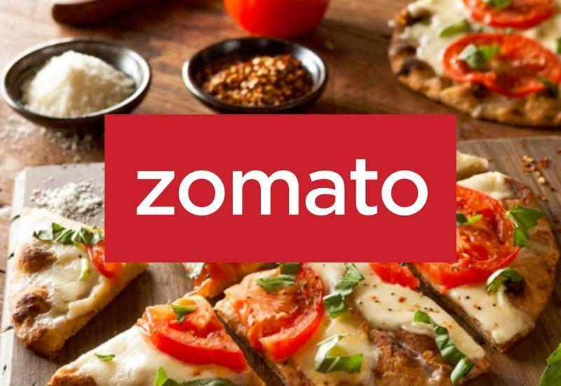
Culinary Adventure
Food Presentation
A journey to deliver a new mouth-watering flavors. Providing an experience exploring a variety of foods and beverages “. "Never Have a Bad Meal."
Presented By
Anuja Shrivastava
Next Slide | 01

Slide 2
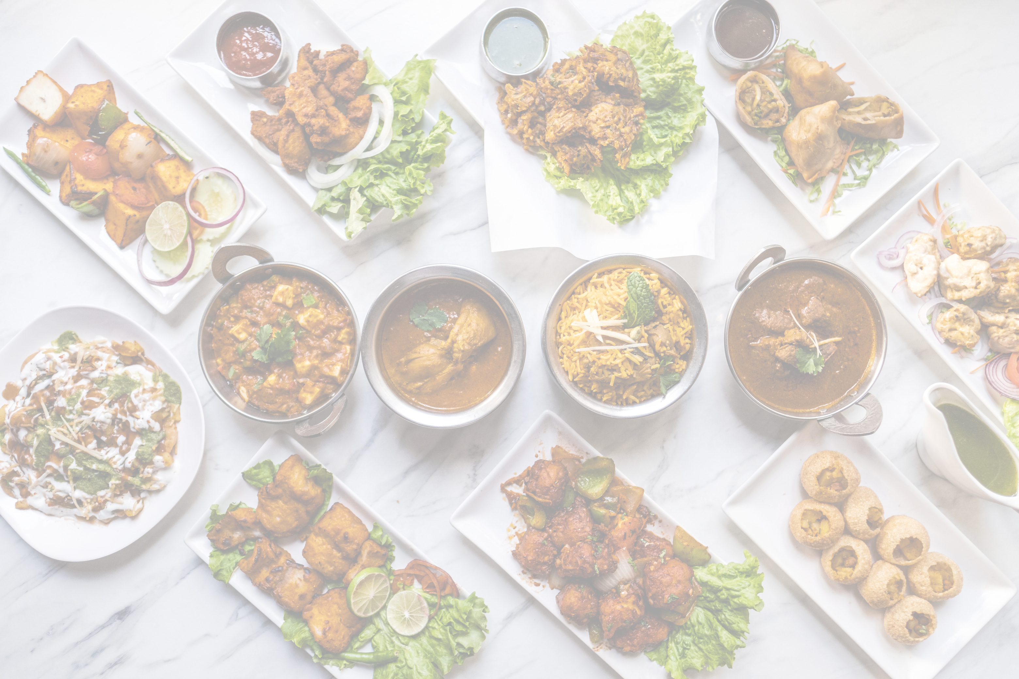

INTRODUCTION
Zomato is an Indian multinational restaurant aggregator and food delivery company.
It was founded by Deepender Goyal and Pankaj Chandah in 2008, Headquarters: Gurugram, India.
Zomato provides information, menus, user reviews of restaurants, and food delivery options from
partner restaurants in more than 1,000 Indian cities and towns, as of 2023–24.

Slide 3



OUR PURPOSE
Mission
Values
To deliver memorable Better food for more people. The company focuses on leveraging technology to enhance the dining and food delivery experience globally.
We deliver quality, memorable experiences, creativity, and community connections.

Slide 4
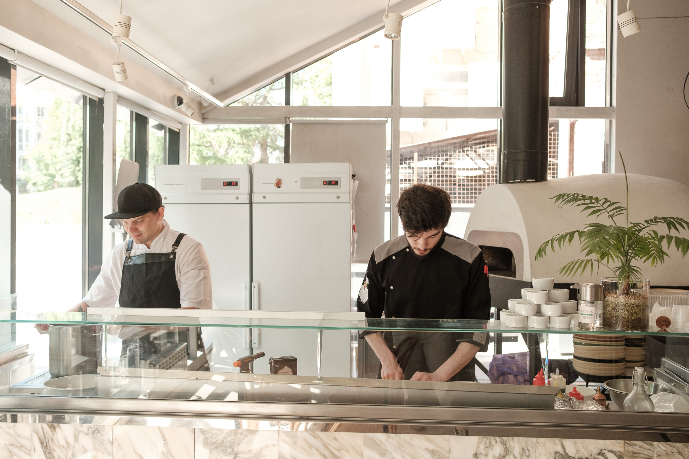
Zomato’s Business Model
Online Food Delivery
Zomato connects customers with restaurants, enabling them to order food online and get it delivered quickly through its app or website.
Restaurant Listings and Reviews
Zomato started as a restaurant discovery platform, allowing users to browse menus, read reviews, and find ratings.
Cloud Kitchen Partnerships
Zomato partners with restaurants to support cloud kitchens (also known as ghost kitchens).
Marketing Support
National and local marketing campaigns tailored to increase visibility and attract customers

Slide 5


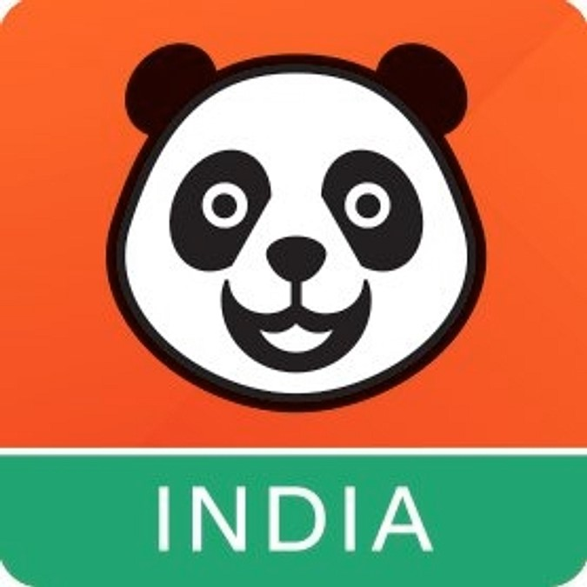

Competitors of Zomato
Swiggy
Food Panda
Eat Sure
"Taste Meets Speed – Swiggy!"
Take the first bite
Take back control of what you eat.

Slide 6
competitive comparison of Zomato, Food panda, and Eat Sure
Feature | Zomato | Foodpanda (Now Defunct in India) | EatSure (By Rebel Foods)
Founded | 2008 | 2012 | 2011
Current Status | Active | Shut Down in India (2019) | Active
Primary Service | Food Delivery & Restaurant Listings | Food Delivery (before exit) | Cloud Kitchen Food Delivery
Operational Countries | India & Global | Exited India, operates in some global markets | India
Business Model | Commissions, Ads, Cloud Kitchens, Subscription Revenue | Commission-based | Direct Sales from Owned Brands
USP (Unique Selling Point) | Extensive restaurant listings, AI-driven recommendations, loyalty programs | Previously a well-known global brand | Focuses on hygiene-certified, quality-controlled food from its own brands
Major Competitor | Swiggy, EatSure, Cloud Kitchens | Swiggy, Zomato (before exit) | Zomato, Swiggy, Cloud Kitchens

Slide 7
MARKET ANALYSIS
No of Restaurants opening based on Year wise
Percentage of restaurant based on bucket range in2024

Slide 8



GROWTH STRATEGY
Market Expansion & Penetration
Technology & AI-Driven Enhancements
Strategic Partnerships & Acquisitions
Increase presence in smaller cities where food delivery is still underpenetrated..
Integrate AI-driven chatbots for seamless food ordering through WhatsApp, Alexa, and Google Assistant..
Acquire or collaborate with cloud kitchen startups for cost-effective food production..

Slide 9
GROWTH STRATEGY
Customer Retention & Loyalty
Sustainability & Corporate Social Responsibility
Marketing & Brand Positioning
Introduce challenges, daily streaks, or food discovery badges for engaging experiences..
Strengthen Zomato Feeding India to minimize food wastage and donate surplus food..
Build forums or social features where foodies can review, share, and discuss food experiences.

Slide 10


Conclusion
Zomato’s business model effectively combines food delivery, restaurant discovery, cloud kitchens, and digital advertising to generate multiple revenue streams. Its focus on technology, customer experience, and partnerships with restaurants has helped it become a dominant player in the food-tech industry.

Slide 11
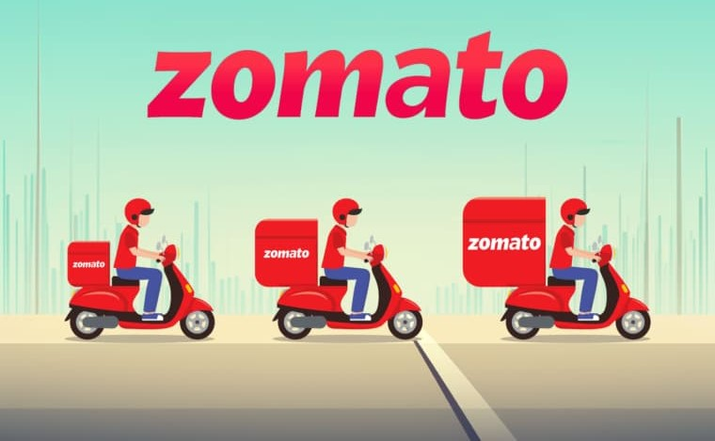
THANK YOU
for considering Zomato. We look forward to partnering with you on a successful culinary journey.
Contact Us
06223-456-7890
hello@zomato.com
Marathahalli 560037
https://www.zomato.com/
https://www.instagram.com/zomato/

